Slide 1
Database Management Systems
Chapter 1
Introduction

Slide 2
introuction
What Is a DBMS?
A very large, integrated collection of data.
Models real-world enterprise.
Entities (e.g., students, courses)
Relationships (e.g., Pradip is taking CS103)
A Database Management System (DBMS) is a software package designed to store and manage databases.

Slide 3
Files vs. DBMS
Application must stage large datasets between main memory and secondary storage (e.g., buffering, page-oriented access, 32-bit addressing, etc.)
Special code for different queries
Must protect data from inconsistency due to multiple concurrent users
Crash recovery
Security and access control

Slide 4
Why Use a DBMS?
Data independence and efficient access.
Reduced application development time.
Data integrity and security.
Uniform data administration.
Concurrent access, recovery from crashes.

Slide 5
Why Study Databases??
Shift from computation to information
at the “low end”: scramble to webspace (a mess!)
at the “high end”: scientific applications
Datasets increasing in diversity and volume.
Digital libraries, interactive video, Human
Genome project, many other Projects
... need for DBMS exploding
DBMS encompasses most of CS
OS, languages, theory, “A”I, multimedia, logic

Slide 6
Data Models
A data model is a collection of concepts for describing data.
A schema is a description of a particular collection of data, using a given data model.
The relational model of data is the most widely used model today.
Main concept: relation, basically a table with rows
and columns.
Every relation has a schema, which describes the
columns, or fields.

Slide 7
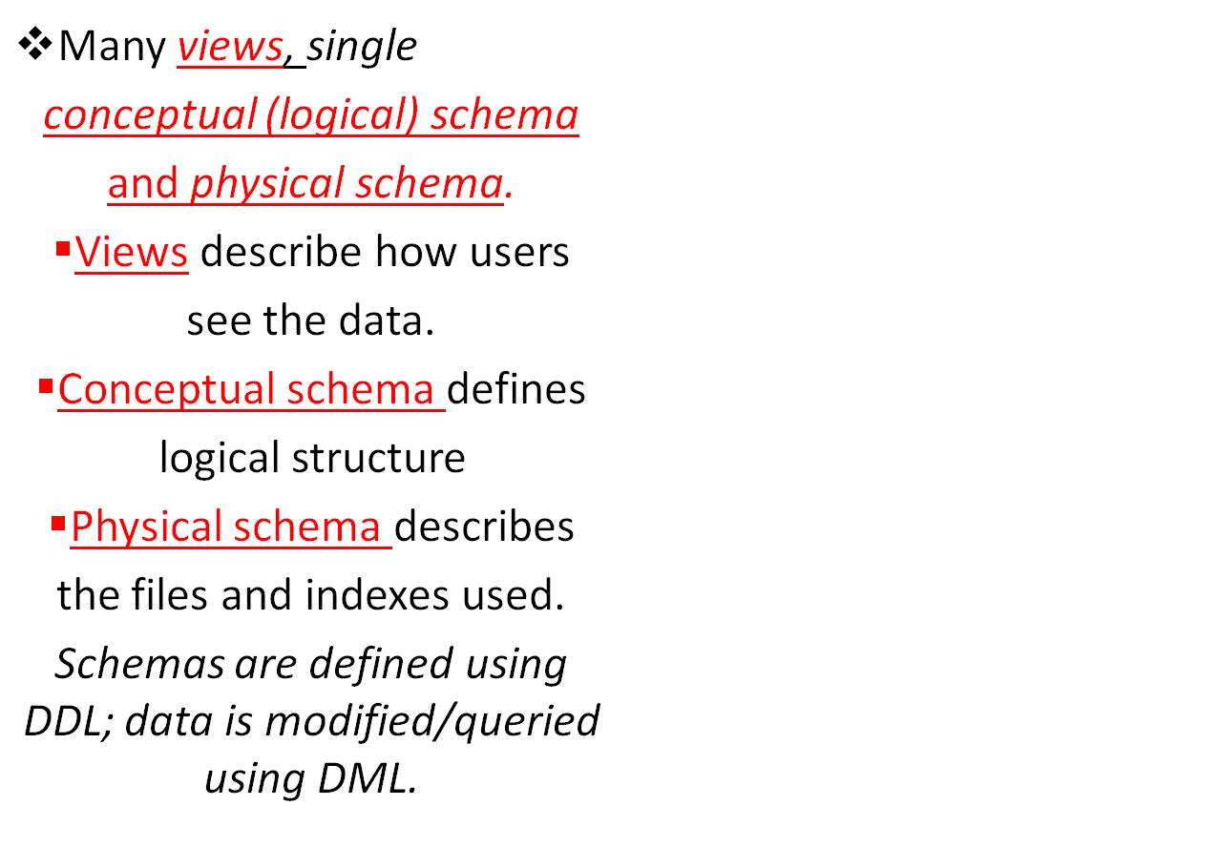
Levels of Abstraction
View1
View2
View3
Conceptual Schema
Physical Schema

Slide 8
Example: University Database
Conceptual schema:
Students(sid: string, name: string, login: string,
age: integer, cgpa:real)
Courses(cid: string, cname:string, credits:integer)
Enrolled(sid:string, cid:string, grade:string)
Physical schema:
Relations stored as unordered files.
Index on first column of Students.
External Schema (View):
Course_info(cid:string,enrollment:integer)

Slide 9
Data Independence
Applications insulated from how data is structured and stored.
Logical data independence: Protection from changes in logical structure of data.
Physical data independence: Protection from changes in physical structure of data.
One of the most important benefits of using a DBMS!

Slide 10
Concurrency Control
Concurrent execution of user programs is essential for good DBMS performance.
Because disk accesses are frequent, and relatively slow, it is important to keep the cpu humming by working on several user programs concurrently.
Interleaving actions of different user programs can lead to inconsistency: e.g., check is cleared while account balance is being computed.
DBMS ensures such problems don’t arise: users can pretend they are using a single-user system.

Slide 11
Transaction: An Execution of a DB Program
Key concept is transaction, which is an atomic sequence of database actions (reads/writes).
Each transaction, executed completely, must leave the DB in a consistent state if DB is consistent when the transaction begins.
Users can specify some simple integrity constraints on the data, and the DBMS will enforce these constraints.
Beyond this, the DBMS does not really understand the semantics of the data. (e.g., it does not understand how the interest on a bank account is computed).
Thus, ensuring that a transaction (run alone) preserves consistency is ultimately the user’s responsibility!

Slide 12
Scheduling Concurrent Transactions
DBMS ensures that execution of {T1, ... , Tn} is equivalent to some serial execution T1’ ... Tn’.
Before reading/writing an object, a transaction requests a lock on the object, and waits till the DBMS gives it the lock. All locks are released at the end of the transaction. (Strict 2PL locking protocol.)
Idea: If an action of Ti (say, writing X) affects Tj (which perhaps reads X), one of them, say Ti, will obtain the lock on X first and Tj is forced to wait until Ti completes; this effectively orders the transactions.
What if Tj already has a lock on Y and Ti later requests a lock on Y? (Deadlock!) Ti or Tj is aborted and restarted!

Slide 13
Ensuring Atomicity
DBMS ensures atomicity (all-or-nothing property) even if system crashes in the middle of a Xact.
Idea: Keep a log (history) of all actions carried out by the DBMS while executing a set of Xacts:
Before a change is made to the database, the corresponding log entry is forced to a safe location. (WAL protocol; OS support for this is often inadequate.)
After a crash, the effects of partially executed transactions are undone using the log. (Thanks to WAL, if log entry wasn’t saved before the crash, corresponding change was not applied to database!)

Slide 14
The Log
The following actions are recorded in the log:
Ti writes an object: the old value and the new value.
  Log record must go to disk before the changed page!
Ti commits/aborts: a log record indicating this action.
Log records chained together by Xact id, so it’s easy to undo a specific Xact (e.g., to resolve a deadlock).
Log is often duplexed and archived on “stable” storage.
All log related activities (and in fact, all CC related activities such as lock/unlock, dealing with deadlocks etc.) are handled transparently by the DBMS.

Slide 15
Databases make these folks happy ..
End users and DBMS vendors
DB application programmers
  E.g. smart webmasters
Database administrator (DBA)
Designs logical /physical schemas
Handles security and authorization
Data availability, crash recovery
Database tuning as needs evolve
Must understand how a DBMS works!

Slide 16
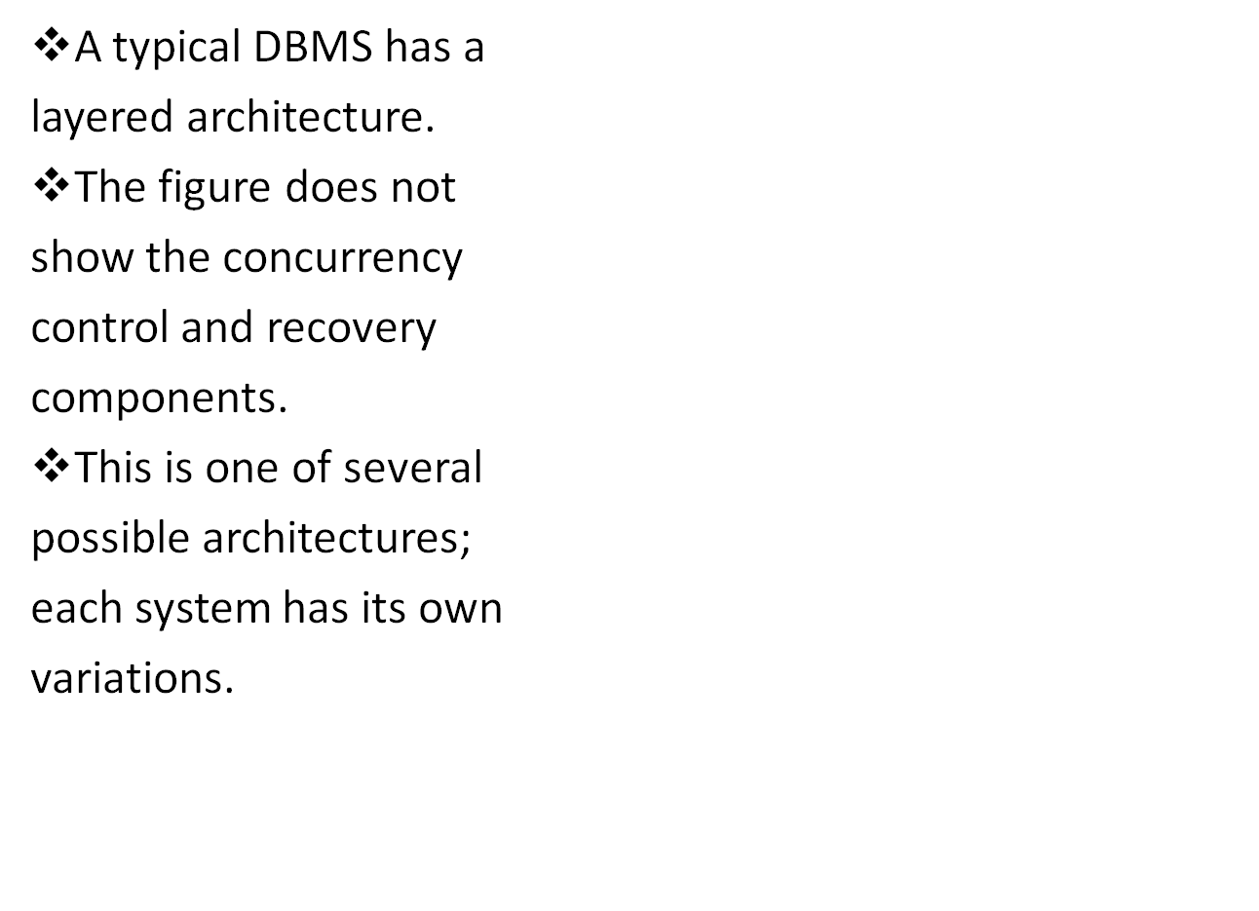
Structure of a DBMS
These layers
must consider
concurrency
control and
recovery
Query Optimization and Execution
Relational Operators
File and Access Methods
Buffer Management
Disk Space Management
DB

Slide 17
Summary
DBMS used to maintain, query large datasets.
Benefits include recovery from system crashes, concurrent access, quick application development, data integrity and security.
Levels of abstraction give data independence.
A DBMS typically has a layered architecture.
DBAs hold responsible jobs and are well-paid!
DBMS R&D is one of the broadest, most exciting areas in CS.

